Slide 1
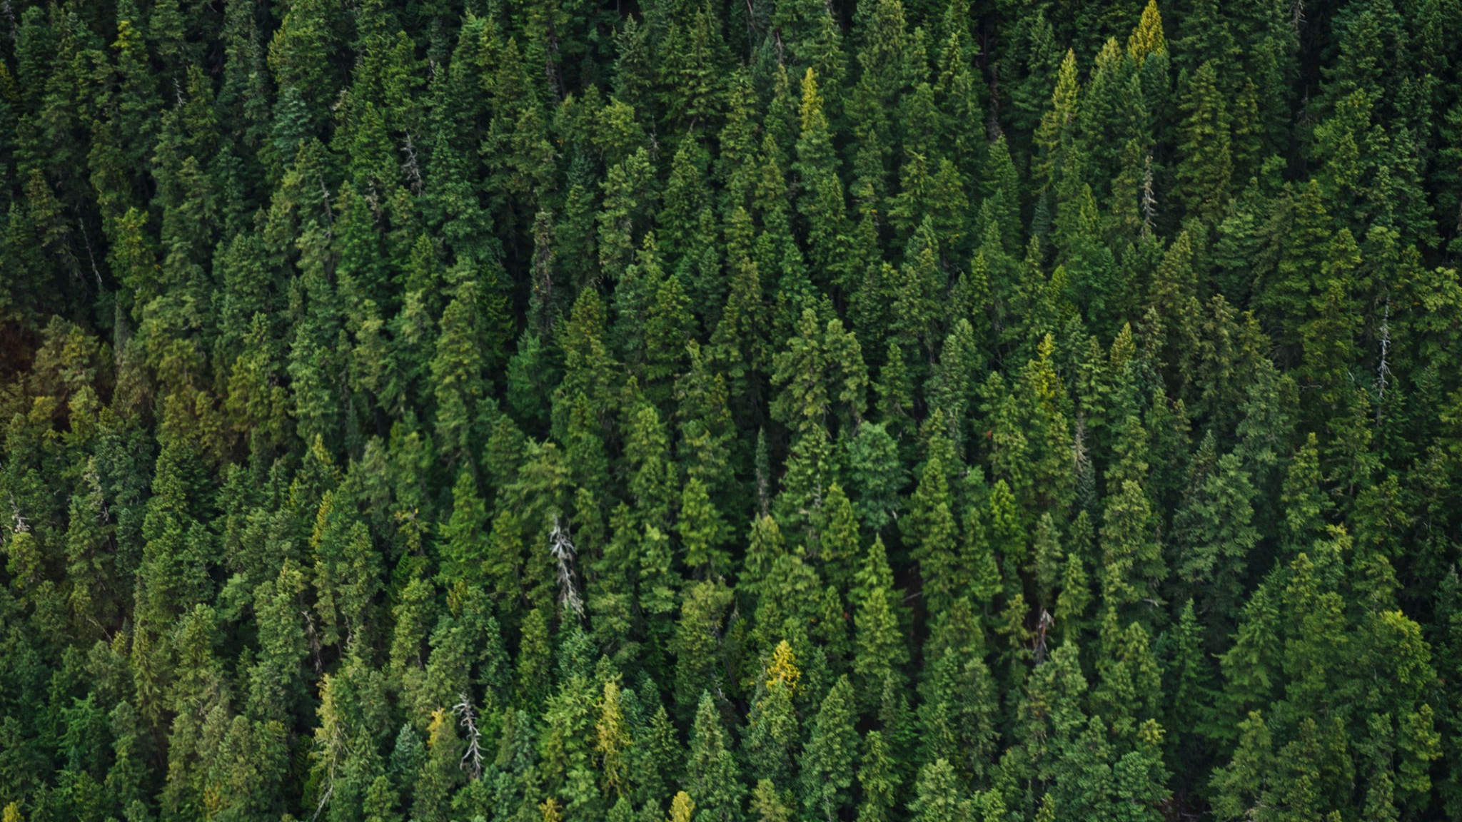
L-Systems, Fractals and Plants
Angus McFarlane
Month DD

Slide 2
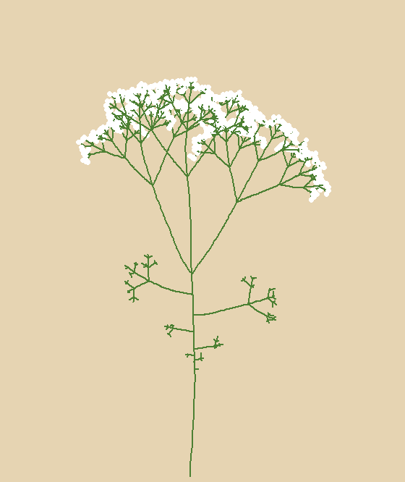
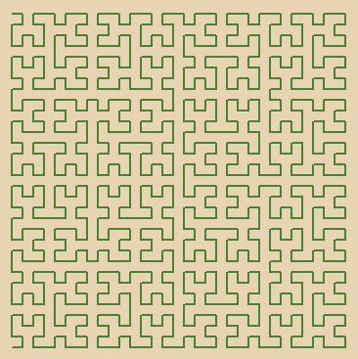
Products of L-Systems

Slide 3
What is an L-System?
Lindenmayer System
In 1968, hungarian biologist, Aristid Lindenmayer, developed a Formal Language to model the reproductive behaviour of bacteria.
Simple Rules
At its most basic level, an L-System consists of a set of rules which define character replacements in an axiom/seed. This seed then ‘grows’ based on these rules as characters are replaced at each step.
Complex Shapes
From these simple rules very complex shapes can emerge.

Slide 4
Example
A
AB → AB
ABA → ABA
ABAAB → ABAAB
Axiom: A
Rules:
A → AB
B → A
ABAABABA → ABAABABA
ABAABABAABAAB → ect.

Slide 5
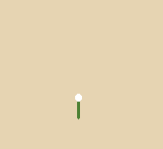
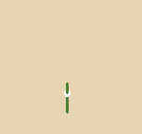
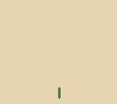
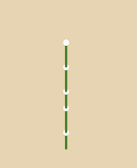


Steps
AB
ABA
A
ABAABABAABAAB
ABAABABA
ABAAB

Slide 6
Links
Section
12
Paper
Online Example
https://algorithmicbotany.org/papers/abop/abop.pdf
https://rue-a.github.io/L-Systems/
Computerphile Code
3D Examples
https://github.com/zac-garby/lsystems
https://github.com/dsmiller95/LindenmayerPlantSimulation/tree/master/DemoPhotos
Examples
My* Code
https://paulbourke.net/fractals/lsys/
https://github.com/A-Mc-F/lsystems

